Slide 1

The Simulation
Deepti Rao and Misha Patel

Slide 2
Users/our purpose
During the Pandemic, it’s important to feel understood, especially in these isolated times
Our goal: to create an entertaining simulation that captures the idea of “insanity”; the user = the main character
Interaction with the simulation; such as stepping challenges in order to reach a new level, and engaging story to follow along

Slide 3
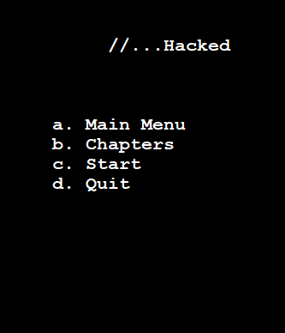
Minigames throughout act as the barrier between one chapter and the next
The game is almost a clicker game, where users tend to destress as they interact with the game
Often, the speech or words present do not necessarily follow a story, yet allow the user to interpret them however they like
“Storyline” and words excerpted from original poetry

Slide 4
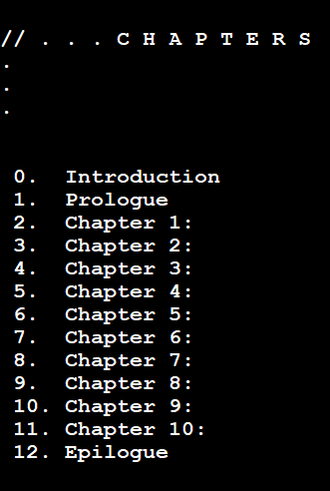

The user base demographic:
for all ages, yet the heavy use of emotion in these games may not be suitable for younger children
Our main aim is teenagers and adults
**inspiration from “Alter Ego,” a popular mobile game

